Slide 1
Vehicle Management System
Group Members:------------------,-----------------
Course Tittle: RDBMS Lab
Course Code:CSSE-403
1

Slide 2

Overview
Introduction
Objective
E-R Diagram
Site Tree
Project View
Login pages
Employee Mode
Sergeant Mode
Owner Mode
Dependencies

Slide 3
Introduction
It is Software developed by python using tkinter module to handle the of Vehicle registration Process
For Adding info, view Info, update info, delete info and many other operation
Helps to crosscheck information between owner and the police sergeant with proper information

Slide 4
Objectives
Eliminate the paper work in the Uzain’ office
Eliminate the huge storage of Physical paper data by storing data into Database.
Simplify search and update process.
Build Digital official Interface to maintain official work digitally

Slide 5
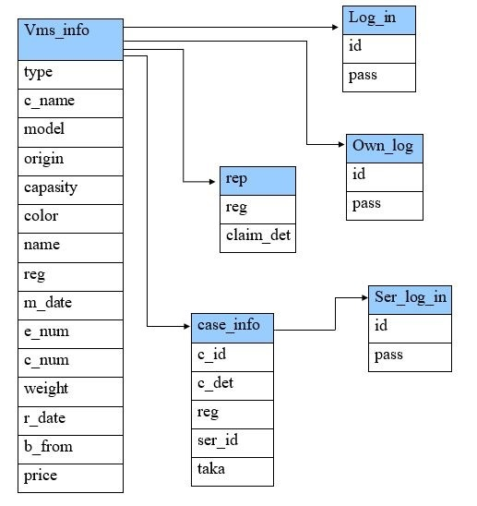
Entity Relationship Diagram
Figure: E-R Diagram of VMS

Slide 6
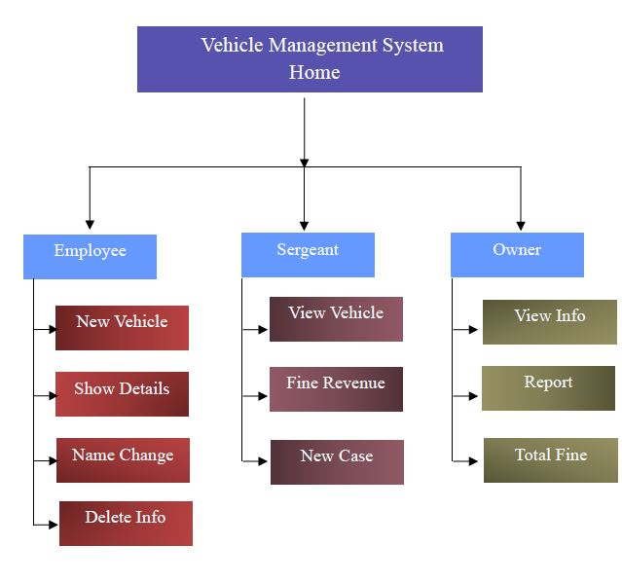
Site Tree
There are three characters. Employee, Owner, Sergeant. Each has a unique view and their own Feature.

Slide 7
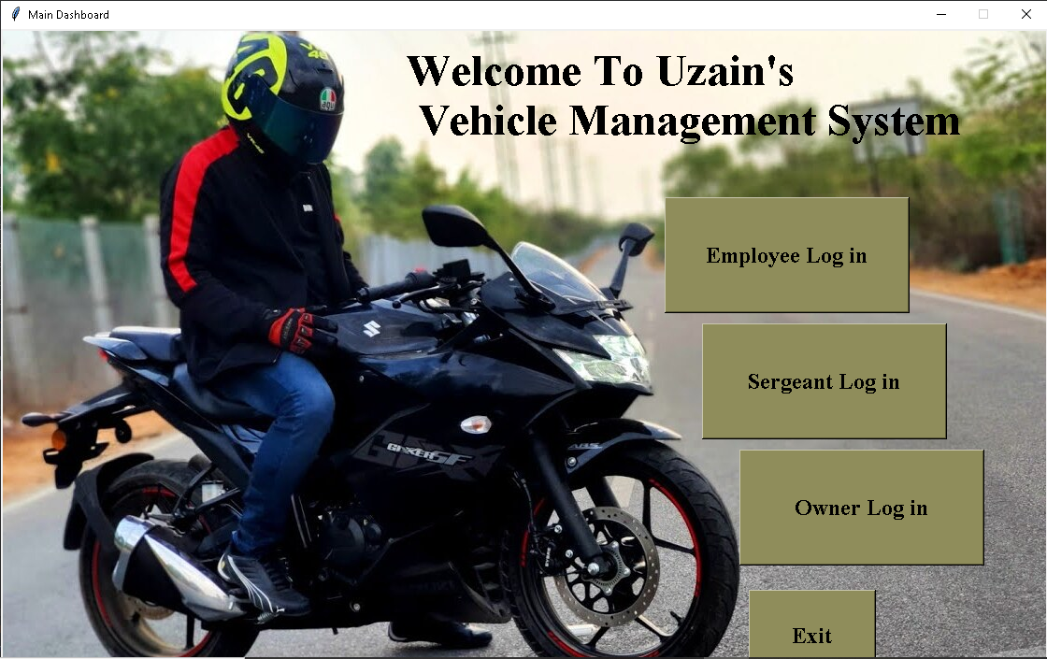
Project View
Home page of Vehicle management System.

Slide 8
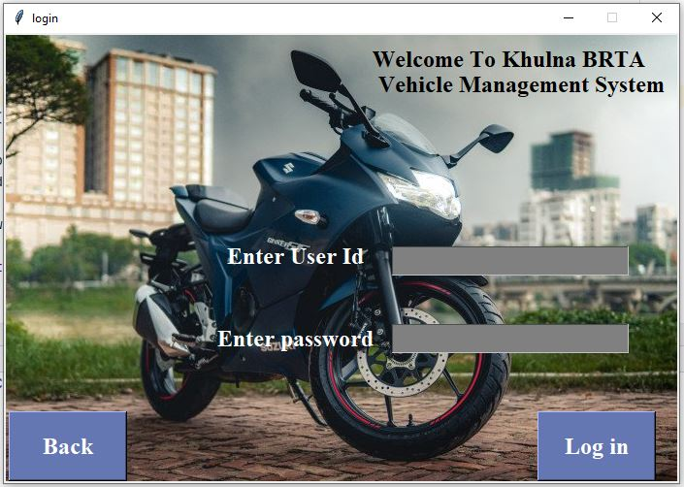
Login Pages

Slide 9
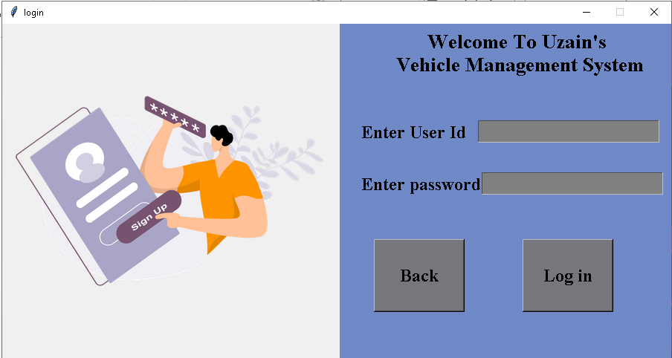
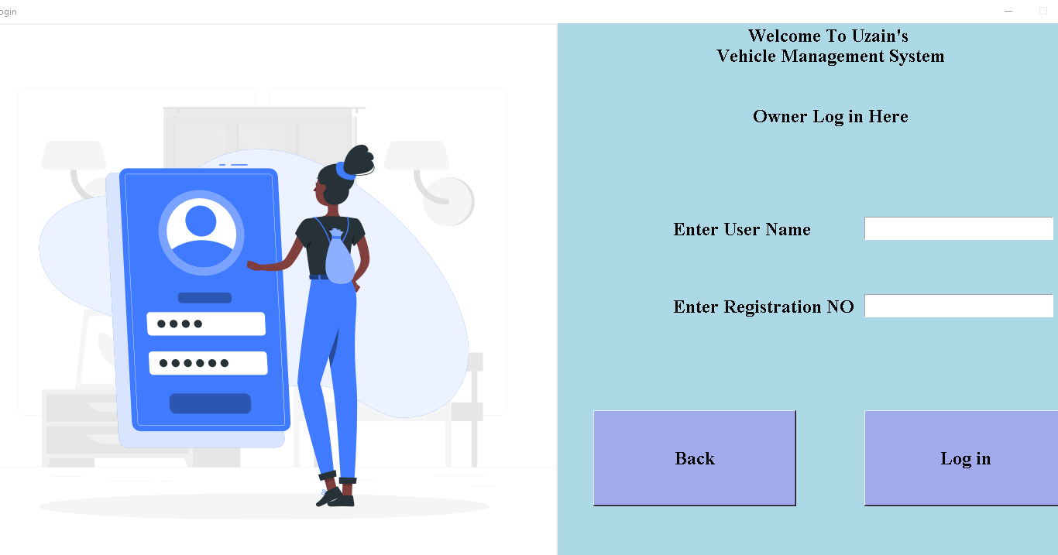
Three characters login pages
9

Slide 10
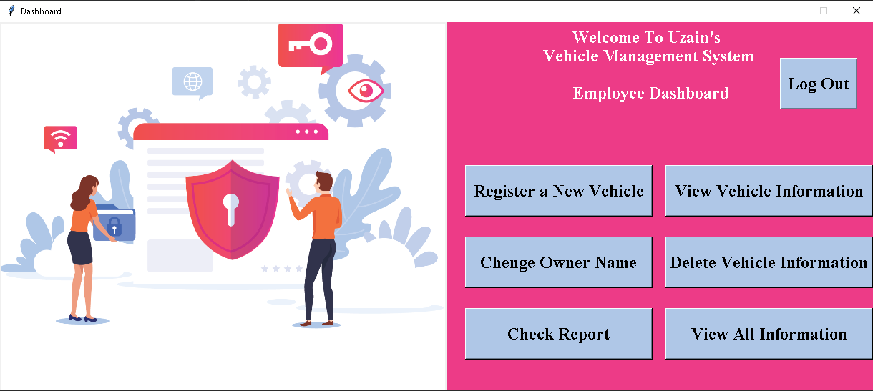
Employee Mode
Login successfully, The Employee can view the Employee dashboard of the Vehicle management system.
An Employee can Add, view, Update, Delete, check the information to the system

Slide 11
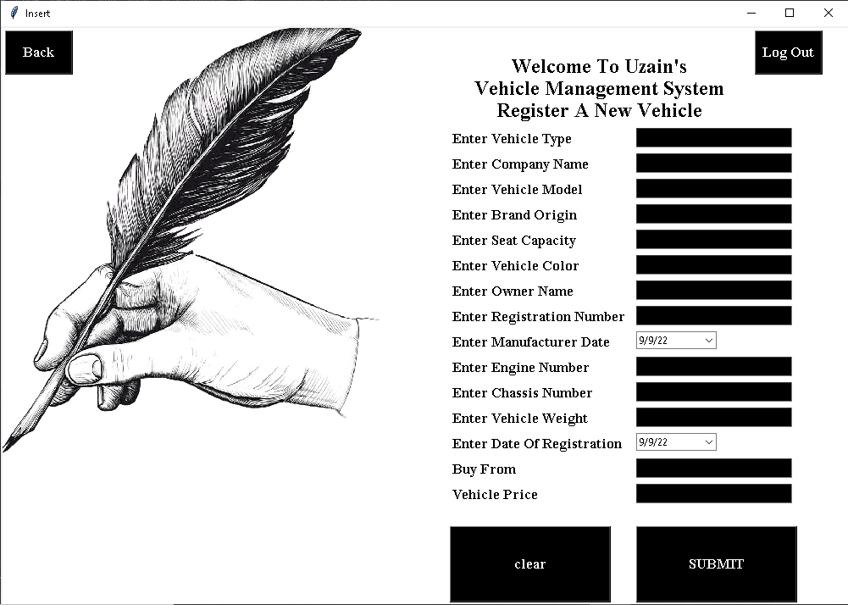
Clicking Register a New Vehicle the Employee will be able to add a new vehicle information

Slide 12
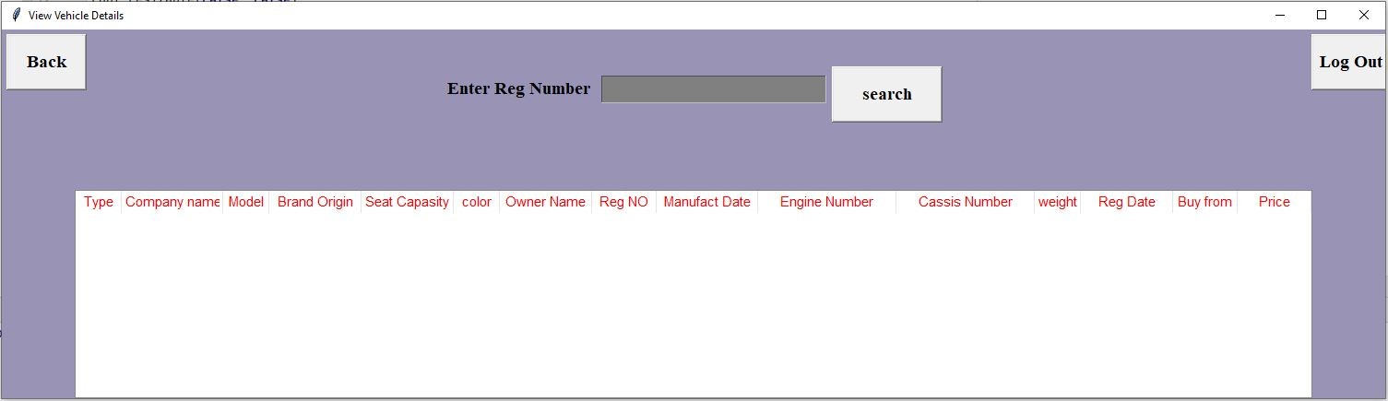
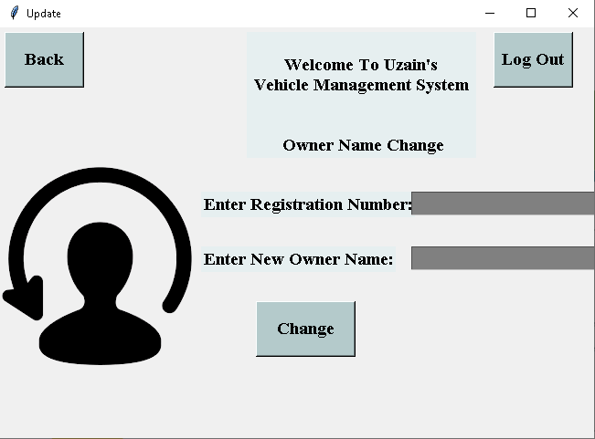
Clicking View Vehicle Information the Employee will be able to View Specific vehicle information
Clicking Change Owner Name the Employee will be able to change The Owner Name.
12

Slide 13
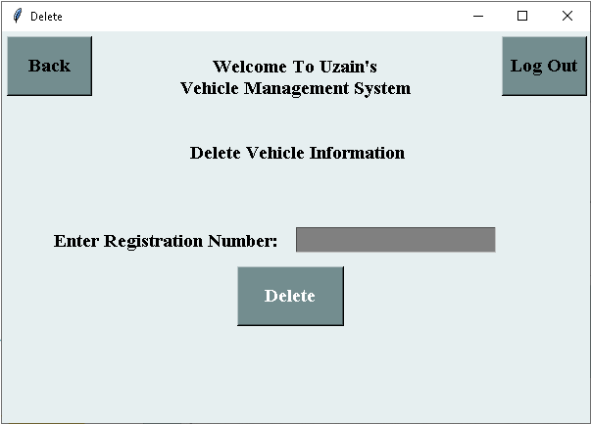
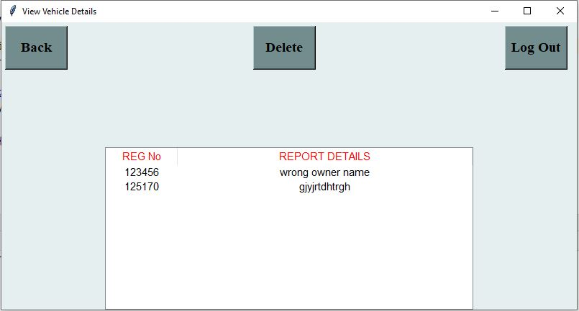
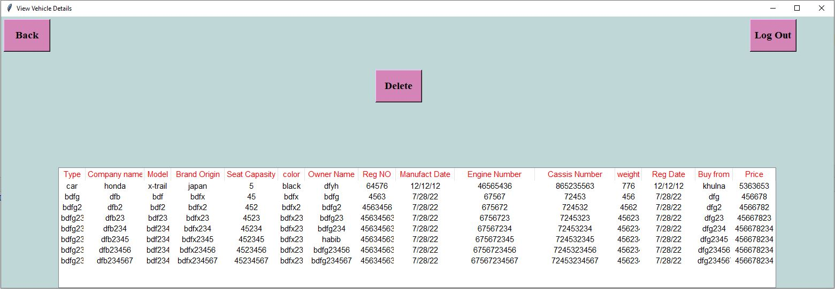
Clicking Delete Vehicle Information the Employee will be able to Delete Specific Vehicle Information
Clicking Check Report the Employee will be able to View the report which is claim by the Vehicle Owner
Clicking Check Report the Employee will be able to View the report which is claim by the Vehicle Owner
13

Slide 14
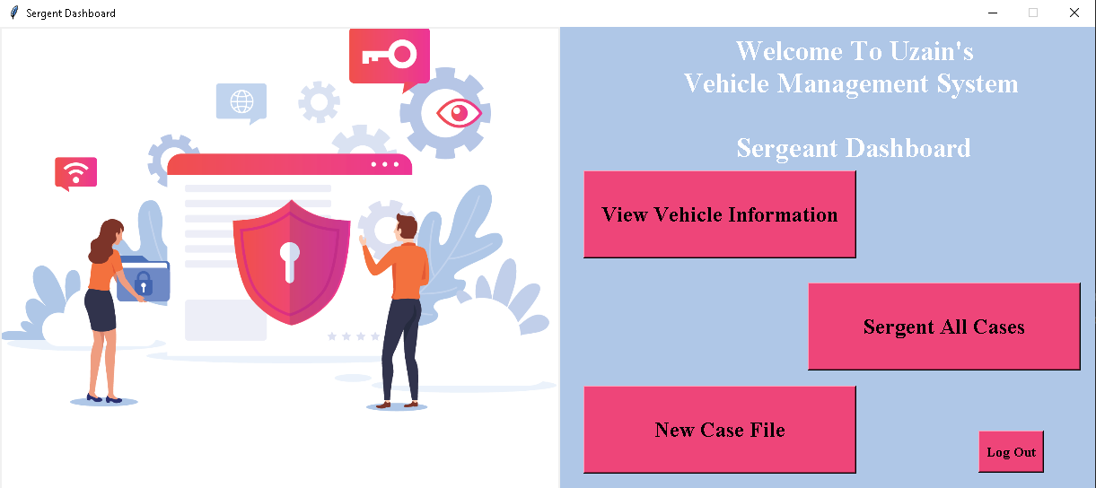
Sergeant Mode
login successfully, The Sergeant can view the Sergeant dashboard of the Vehicle management system.
a Sergeant can add, view and check the information to the system.

Slide 15
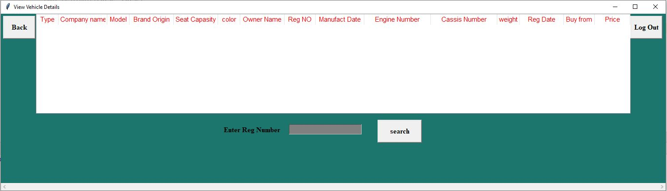
Clicking View Vehicle Information the Sergeant will be able to View Specific vehicle information searching by Registration Number
15

Slide 16
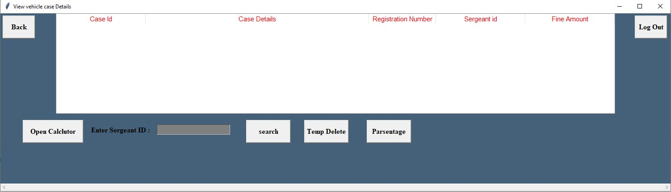


Clicking Sergeant All Case the Sergeant will be able to View All case which is noted by specific sergeant
16

Slide 17
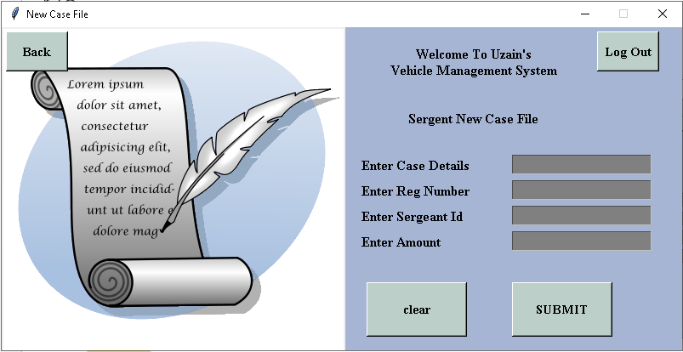
Clicking New Case File the Sergeant will be able to Note a new case.
17

Slide 18
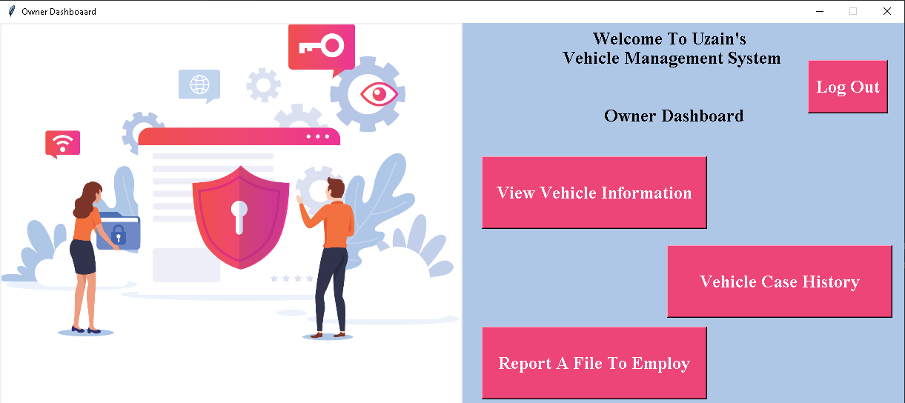
Owner Mode
login successfully, The Owner can view the Owner dashboard of the Vehicle management system.
an Owner can add Report, view and check the information to the system
i

Slide 19
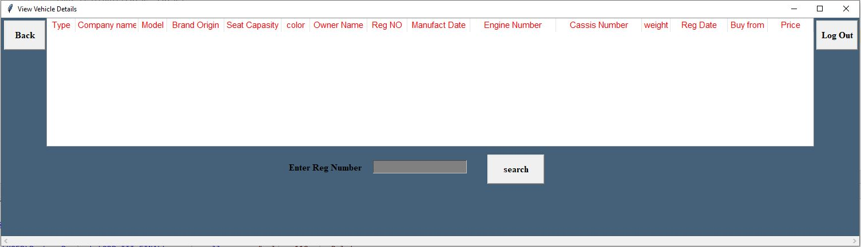
Clicking View Vehicle Information the Owner will able to View his vehicle information searching with his registration number
19

Slide 20
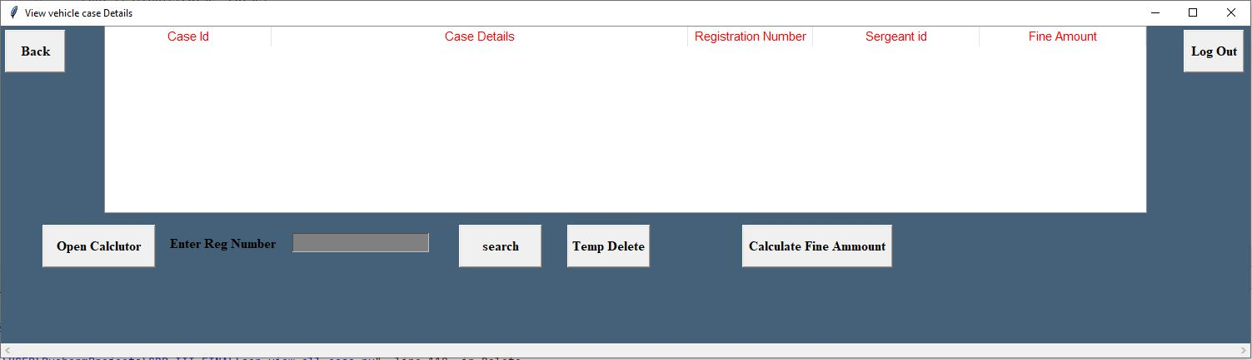
Clicking Vehicle Case History the Owner will be able to view all case which is noted for his vehicle
20

Slide 21
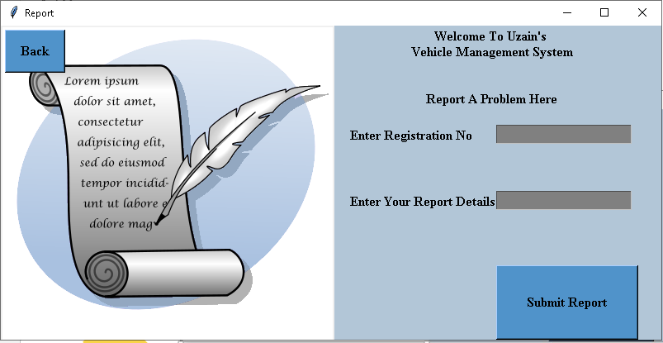
Clicking Report A file to employee the Owner will be able to note a complaint against Employee.
21

Slide 22
Dependencies:
MySql: The Vehicle Management system (vms)’s database is Store in local server. So MySql is needed to run this project properly
Pycharm: For built this project we use Python language and Python Built in Packages.
Tkinter: We have used Python Tkinter Module for the User Interface. So, you must have to import the Tkinter Module for successfully executing this project.
22

Slide 23
Conclusion:
The system developed with future development possibilities in consideration.
The project build digital official interface to maintain officials work digitally.
Eliminate the huge storage of Physical paper data by storing data into Database.
Simplify search and update process
23

Slide 24

Thank you

